Slide 1
Grade Pulse

Slide 2
Task Overview
Goal:
Students are to be recorded with their grades in the individual subjects.
1. editing the list of students 2. editing the list of subjects 3. editing the grades using a crosstab

Slide 3
Technologies Used
Frontend
Angular 17.3.12
BackEnd
C# .Net Core Rest API
Database
SQLite with Entity Framework

Slide 4
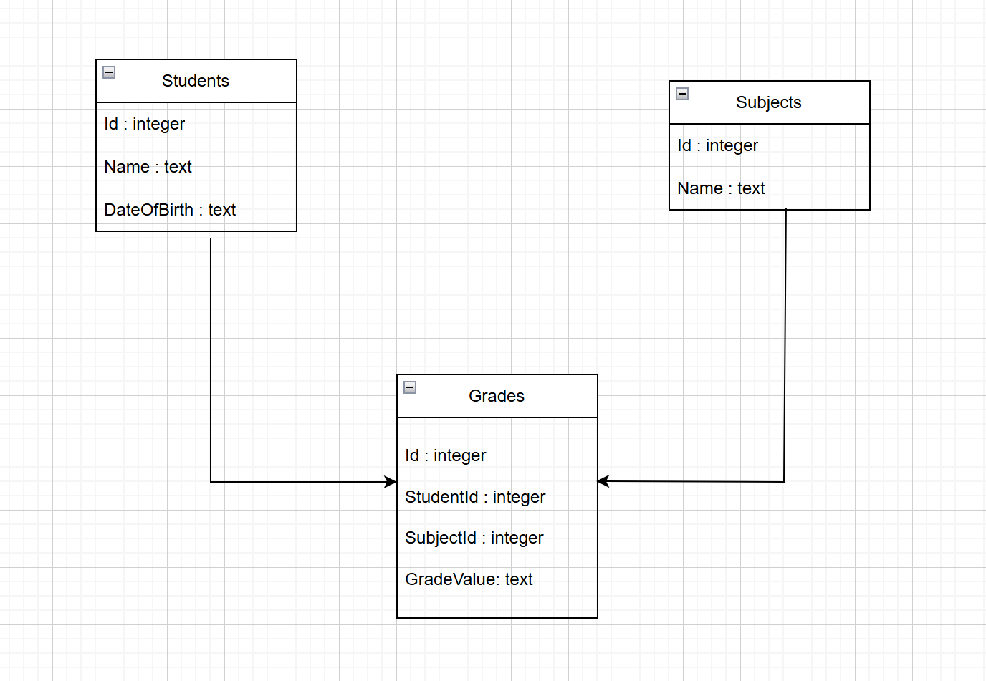
Table Design
Main Tables
Students: Details like ID, Name, and DOB
Subjects: Subject ID, Name Grades: Includes Student ID, Subject ID, and Grade Value

Slide 5
Core Functionalities
Edit Students:
Edit Subjects:
Edit Gradings
Display Grades in a Crosstab:

Slide 6
Backend Implementation
REST API Endpoints:
CRUD operations for Students
CRUD operations for Subjects
CRUD operations for Grades
Display Crosstab data for Grades
Entity Framework:
Generic Repository Pattern

Slide 7
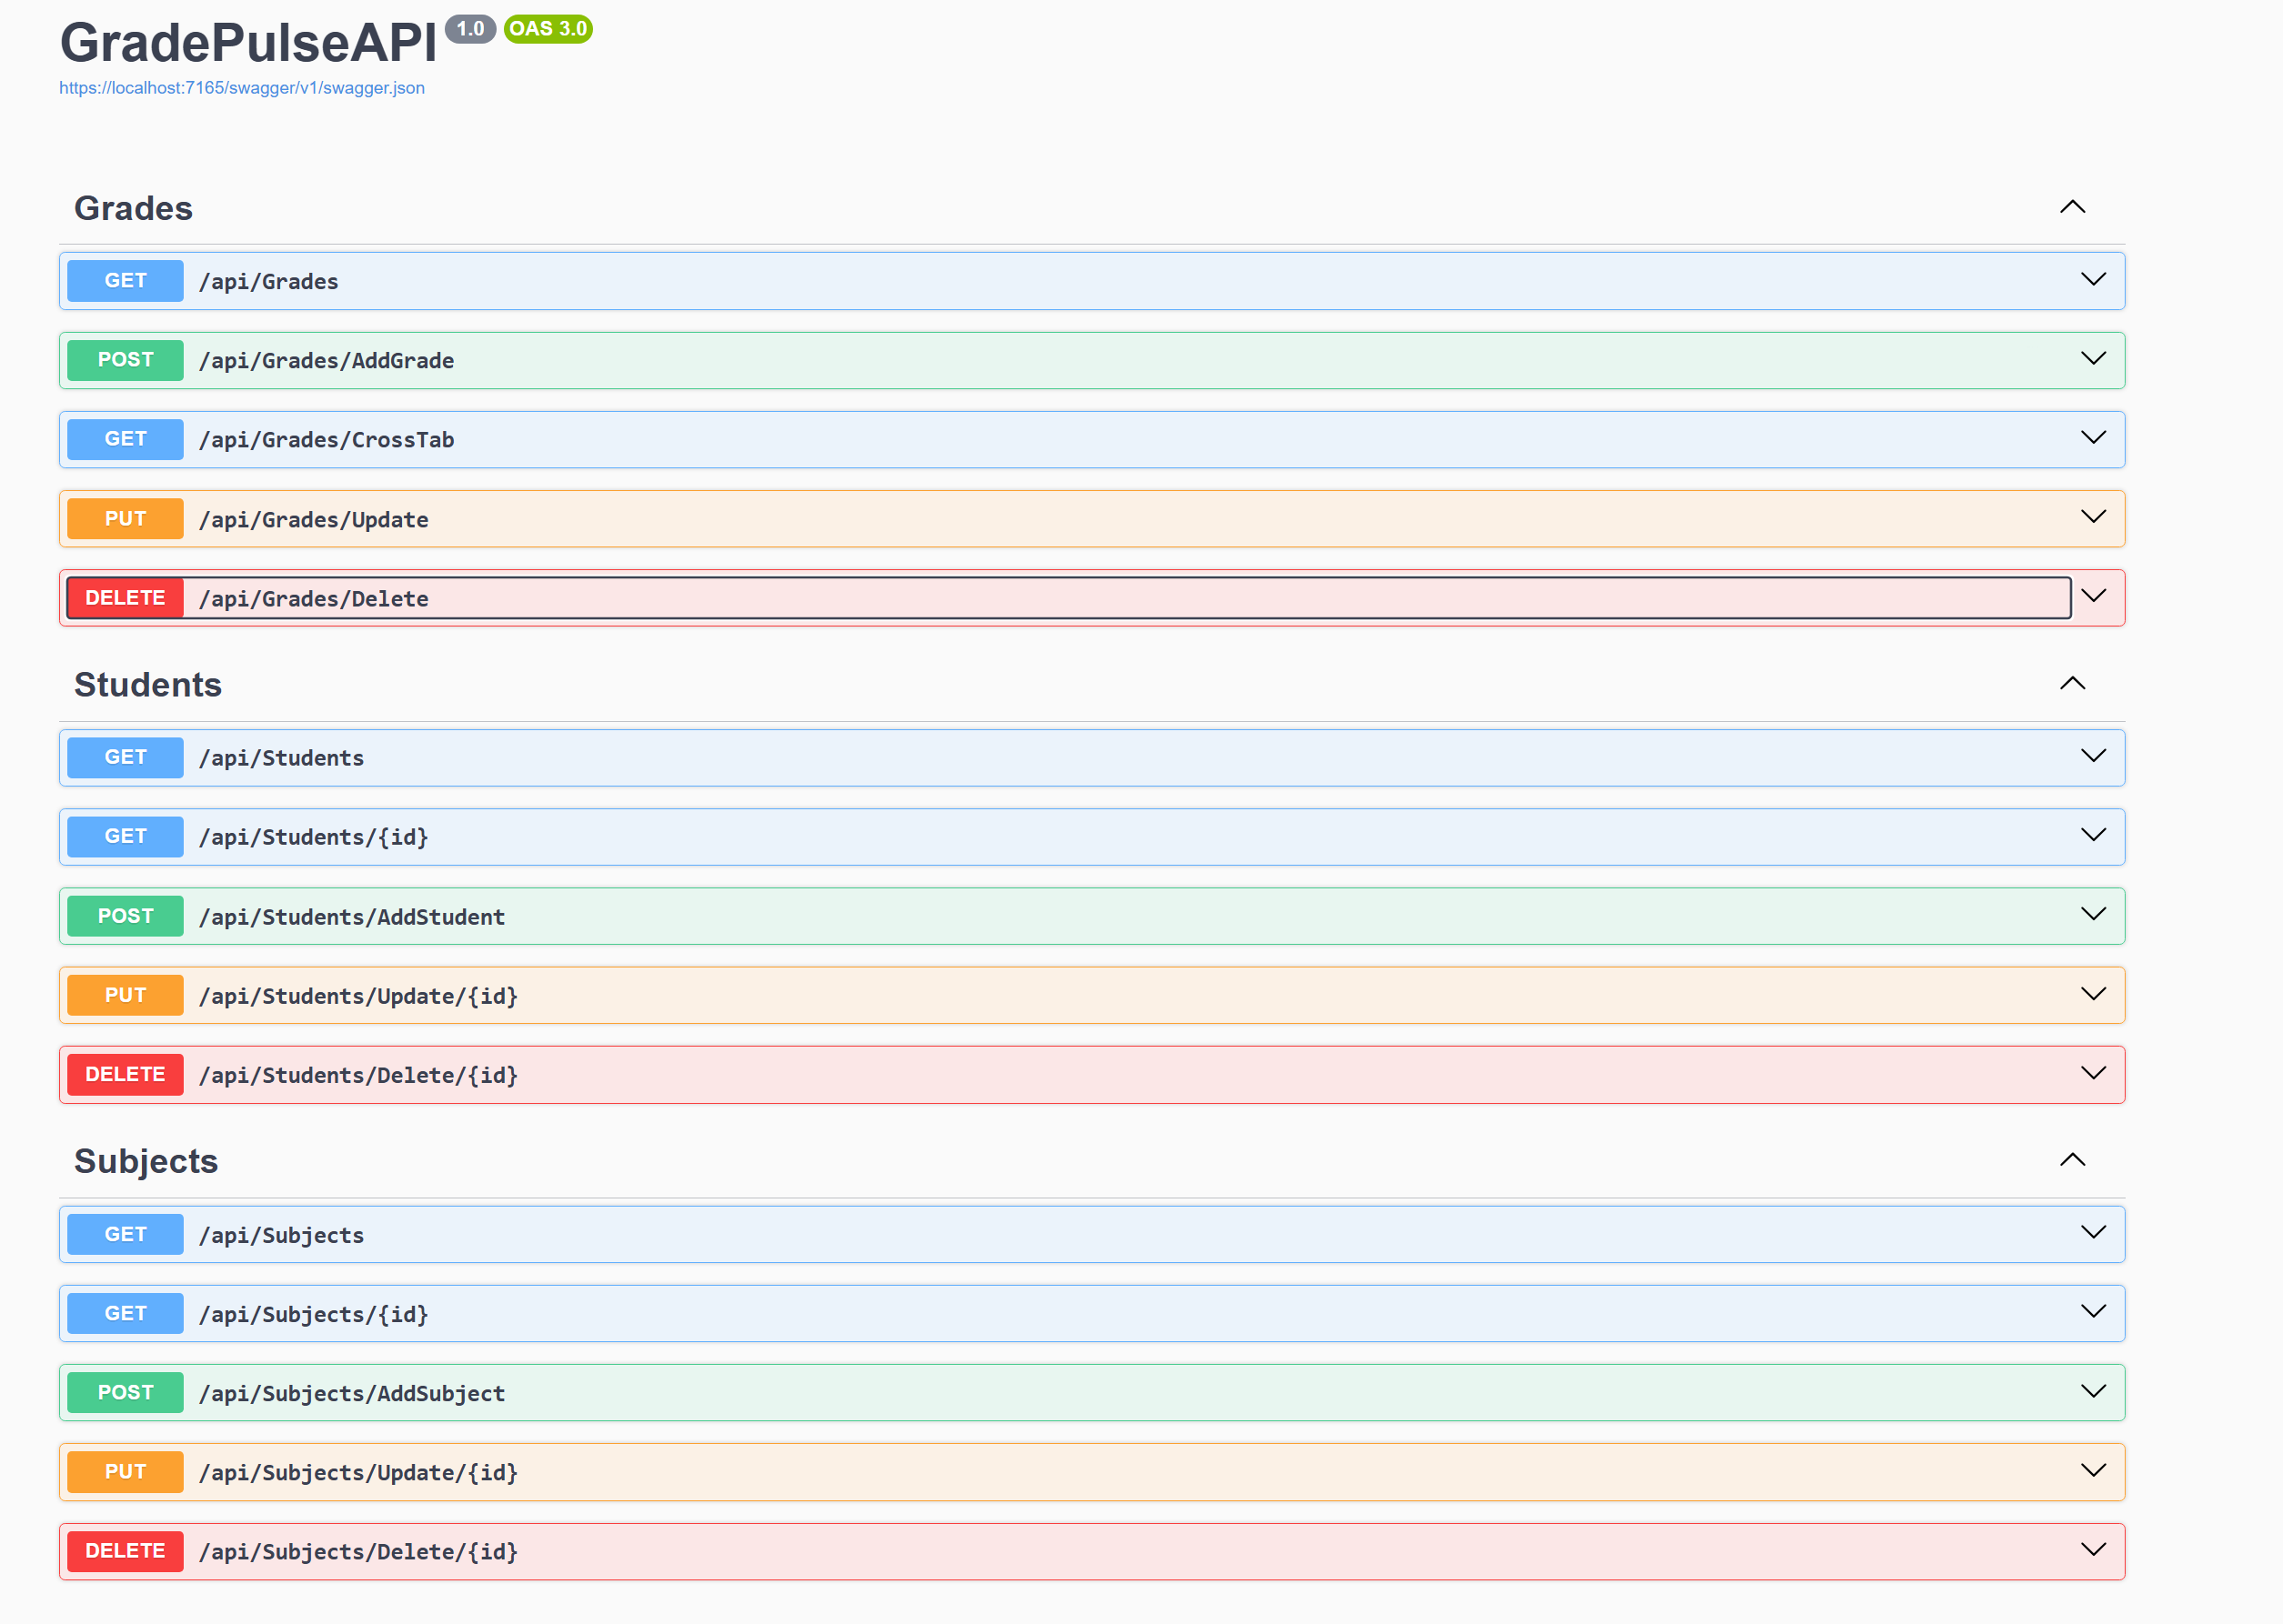
Backend Implementation
Swagger Documentation

Slide 8
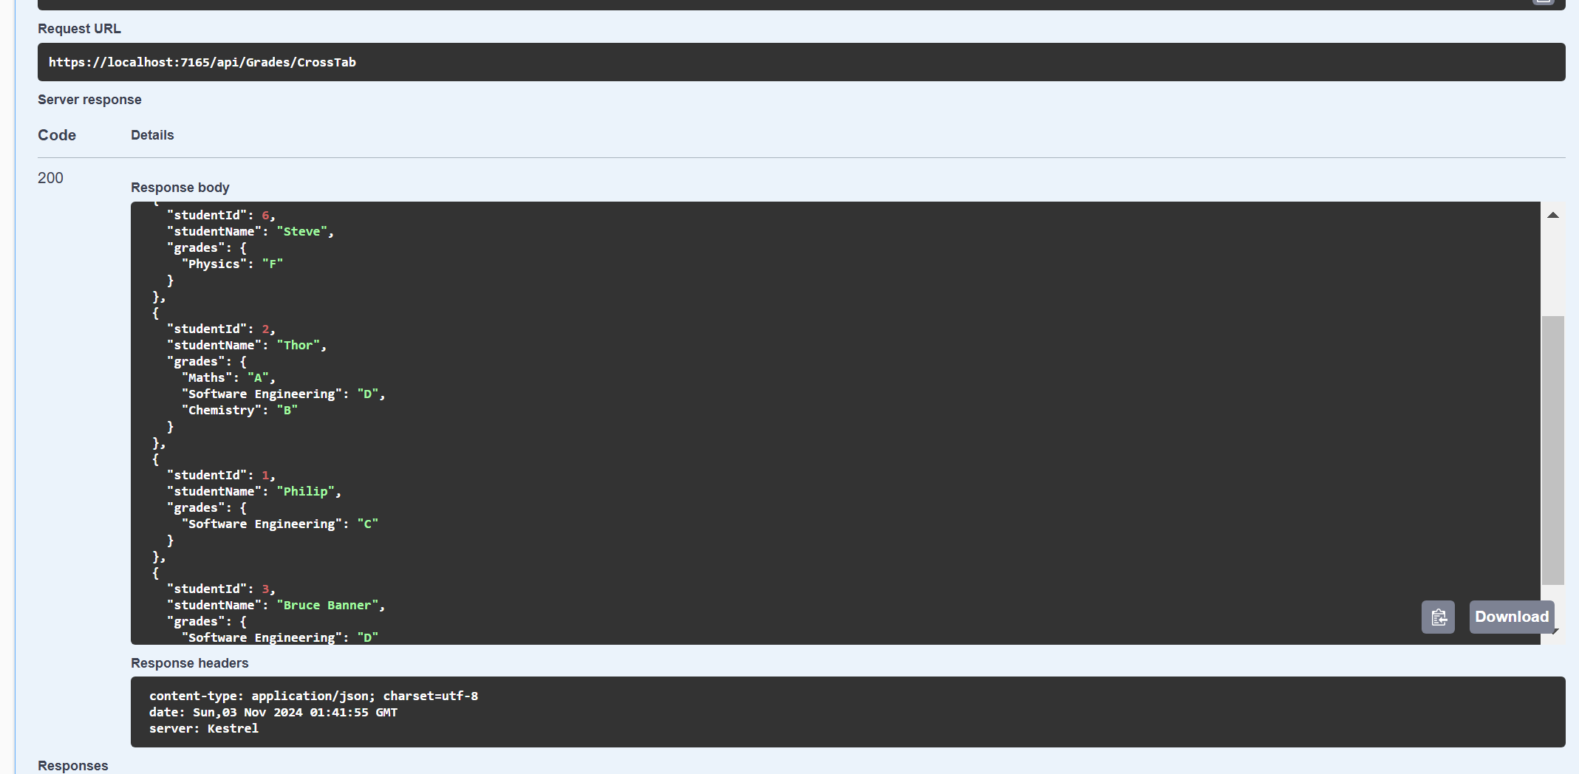
Backend Implementation
Crosstab Response Structure

Slide 9
Frontend Implementation
Angular Components.
Student Management
Subject Management
Grade Management
UI Elements
Bootstrap

Slide 10
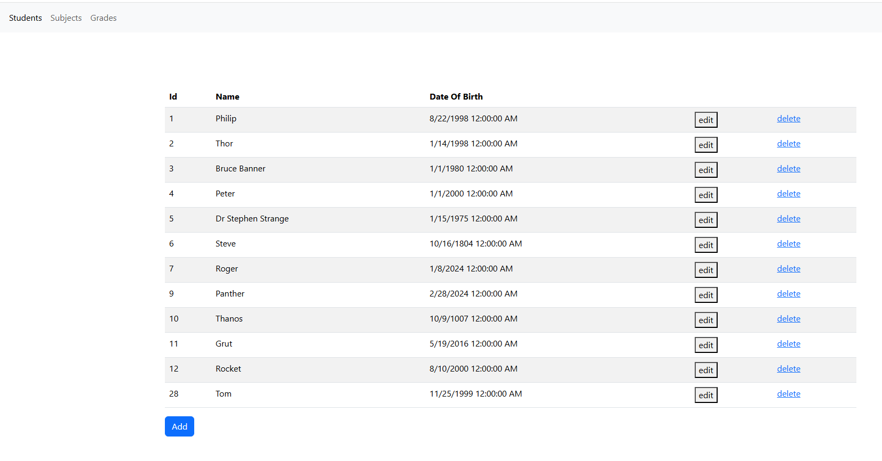
Frontend Implementation
Student Management

Slide 11
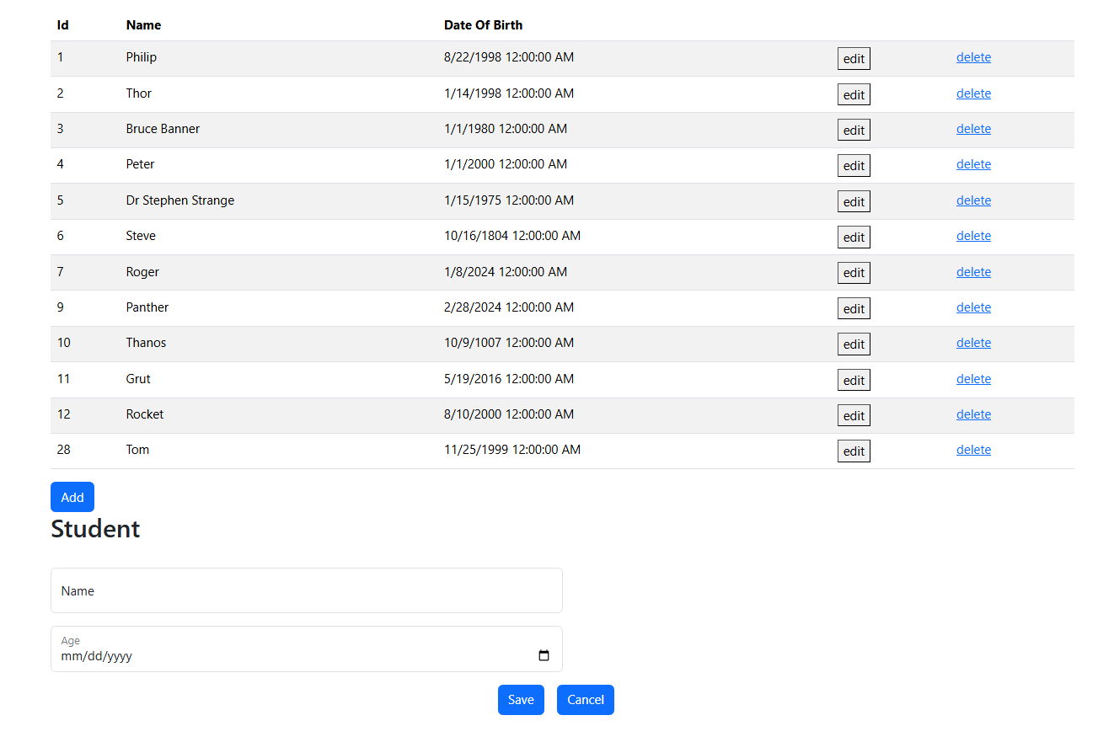
Frontend Implementation

Slide 12
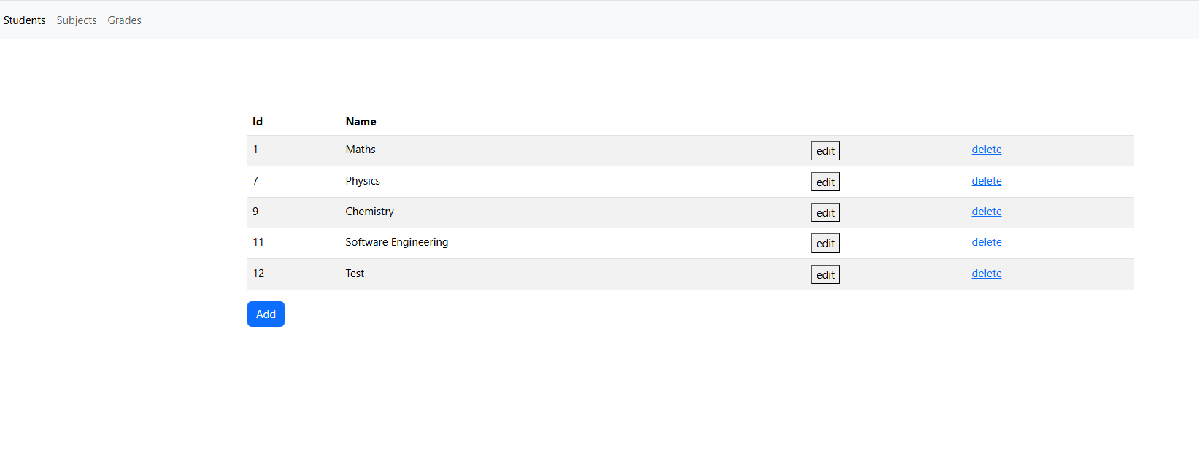
Frontend Implementation
Subject Management

Slide 13
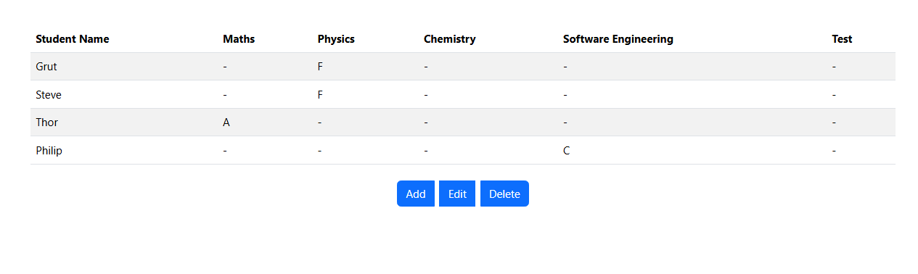
Frontend Implementation
Grade Management

Slide 14
Frontend Implementation
Grade Management

Slide 15
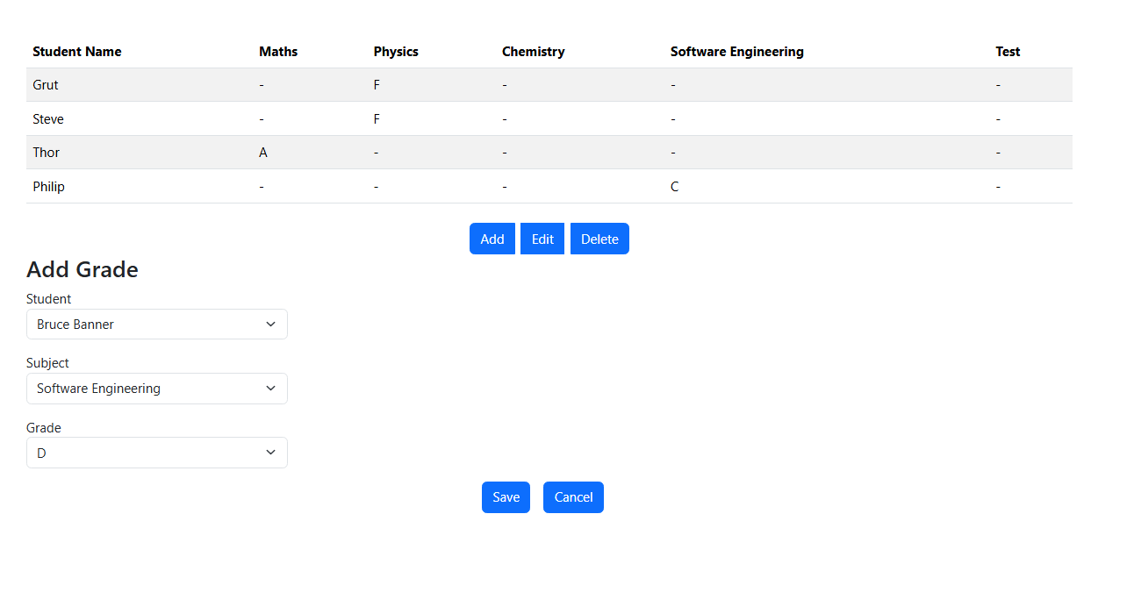
Frontend Implementation
Grade Management

Slide 16
DEMO

Slide 17
Thank you
Jubish Kammily

